Slide 1
FinTrack
Mid-term defense
Presented by:
Amit Baral
Sangam Subedi
Prabin Shrestha

Slide 2
Introduction
Comprehensive financial management solution
Combines mobile app + web-based admin panel
Features:
  Log daily transactions
  Categorize spending
  Set budgets & review reports
Goal: Promote financial literacy & smart decision-making

Slide 3
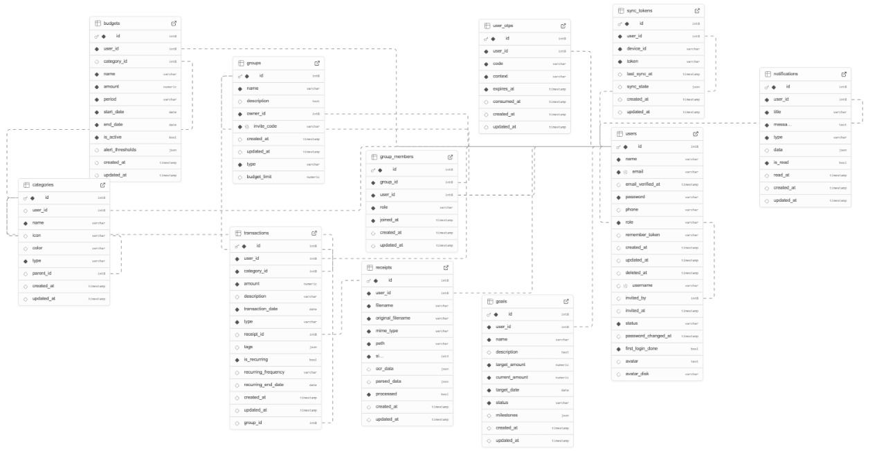
Database Schema

Slide 4
Completed
Login
Register
Forget password

Slide 5
Remaining
Dashboard and rest
Documentation
AI integration
Mobile app

Slide 6
Problem faced
Not having enough knowledge
Database connection

Slide 7
Contributions

